Slide 1
ZigBee/IEEE 802.15.4 Overview

Slide 2
New trend of wireless technology
Most Wireless industry focuses on increasing high data throughput
A set of applications require simple wireless connectivity, relaxed throughput, very low power, short distance and inexpensive hardware.
Industrial
Agricultural
Vehicular
Residential
Medical

Slide 3

What is ZigBee Alliance?
An organization with a mission to define reliable, cost effective, low-power, wirelessly networked, monitoring and control products based on an open global standard
Alliance provides interoperability, certification testing, and branding

Slide 4
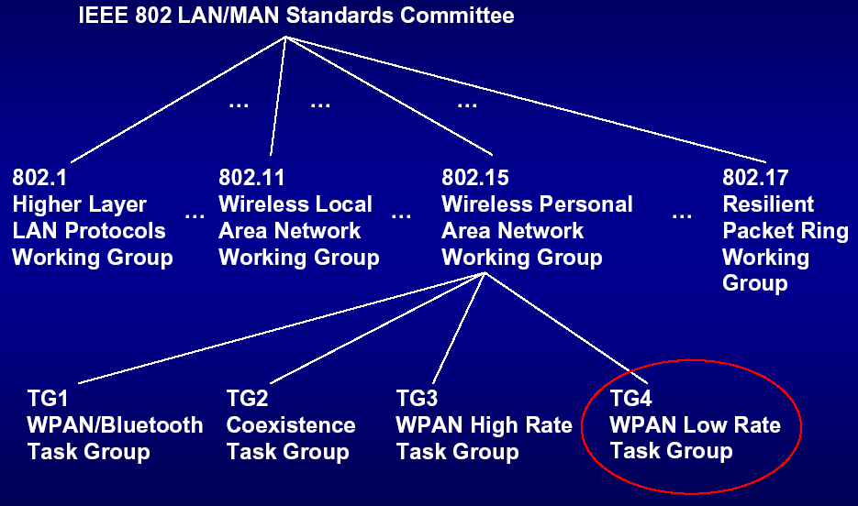
IEEE 802.15 working group

Slide 5
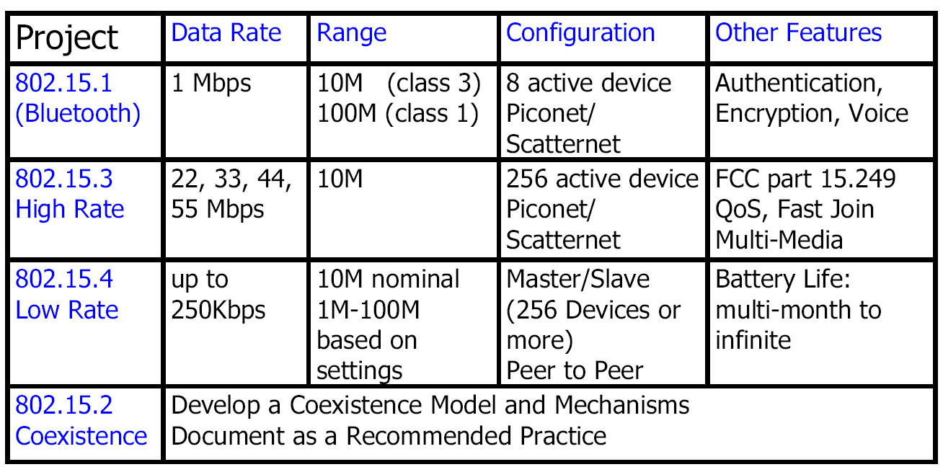
Comparison between WPAN

Slide 6
ZigBee/IEEE 802.15.4 market feature
Low power consumption
Low cost
Low offered message throughput
Supports large network orders (<= 65k nodes)
Low to no QoS guarantees
Flexible protocol design suitable for many applications

Slide 7






ZigBee network applications
INDUSTRIAL & COMMERCIAL
CONSUMER ELECTRONICS
monitors
sensors
automation
control
TV VCR
DVD/CD
Remote control
PERSONAL HEALTH CARE
PC & PERIPHERALS
monitors
diagnostics
sensors
ZigBee
LOW DATA-RATE
RADIO DEVICES
mouse
keyboard
joystick
TOYS &
GAMES
HOME AUTOMATION
consoles portables
educational
security
HVAC
lighting
closures

Slide 8
Wireless technologies
Range
Meters
GSM
GPRS
EDGE
3G
2000
10,000
2003-4
2005
1,000
802.11b
802.11a/g
100
ZigBee
Hiper
LAN/2
Bluetooth 2.0
Bluetooth
Bandwidth
kbps
10
Bluetooth 1.5
WiMedia
10
100
1,000
10,000
100,000

Slide 9
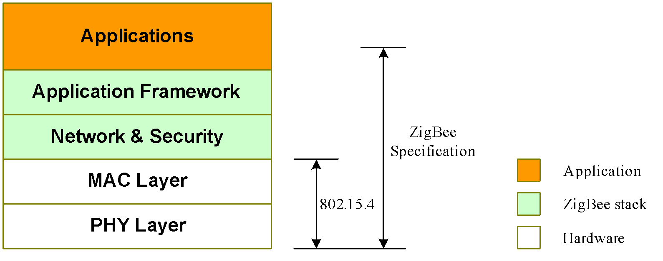
ZigBee/802.15.4 architecture
ZigBee Alliance
45+ companies: semiconductor mfrs, IP providers, OEMs, etc.
Defining upper layers of protocol stack: from network to application, including application profiles
First profiles published mid 2003
IEEE 802.15.4 Working Group
Defining lower layers of protocol stack: MAC and PHY

Slide 10
How is ZigBee related to IEEE 802.15.4?
ZigBee takes full advantage of a powerful physical radio specified by IEEE 802.15.4
ZigBee adds logical network, security and application software
ZigBee continues to work closely with the IEEE to ensure an integrated and complete solution for the market

Slide 11
IEEE 802.15.4 overview

Slide 12
General characteristics
Data rates of 250 kbps , 20 kbps and 40kpbs.
Star or Peer-to-Peer operation.
Support for low latency devices.
CSMA-CA channel access.
Dynamic device addressing.
Fully handshaked protocol for transfer reliability.
Low power consumption.
Channels:
16 channels in the 2.4GHz ISM band,
10 channels in the 915MHz ISM band
1 channel in the European 868MHz band.
Extremely low duty-cycle (<0.1%)

Slide 13
IEEE 802.15.4 basics
802.15.4 is a simple packet data protocol for lightweight wireless networks
Channel Access is via Carrier Sense Multiple Access with collision avoidance and optional time slotting
Message acknowledgement
Optional beacon structure
Target applications
Long battery life, selectable latency for controllers, sensors, remote monitoring and portable electronics
Configured for maximum battery life, has the potential to last as long as the shelf life of most batteries

Slide 14
IEEE 802.15.4 Device Types
There are two different device types :
A full function device (FFD)
A reduced function device (RFD)
The FFD can operate in three modes by serving as
Device
Coordinator
PAN coordinator
The RFD can only serve as:
Device

Slide 15
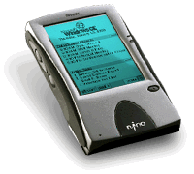
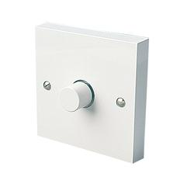
FFD vs RFD
Full function device (FFD)
Any topology
Network coordinator capable
Talks to any other device
Reduced function device (RFD)
Limited to star topology
Cannot become a network coordinator
Talks only to a network coordinator
Very simple implementation

Slide 16
Star topology
Network
Network
coordinator
coordinator
Master/slave
Full Function Device (FFD)
Reduced Function Device (RFD)
Communications Flow

Slide 17
Peer to peer topology
Point to point
Tree
Full Function Device (FFD)
Communications Flow

Slide 18
Device addressing
Two or more devices communicating on the same physical channel constitute a WPAN.
A WPAN includes at least one FFD (PAN coordinator)
Each independent PAN will select a unique PAN identifier
Each device operating on a network has a unique 64-bit extended address. This address can be used for direct communication in the PAN
A device also has a 16-bit short address, which is allocated by the PAN coordinator when the device associates with its coordinator.

Slide 19
IEEE 802.15.4 physical layer

Slide 20
IEEE 802.15.4 PHY overview
PHY functionalities:
Activation and deactivation of the radio transceiver
Energy detection within the current channel
Link quality indication for received packets
Clear channel assessment for CSMA-CA
Channel frequency selection
Data transmission and reception

Slide 21
IEEE 802.15.4 PHY Overview
Operating frequency bands
868MHz/
915MHz
PHY
Channel 0
Channels 1-10
2 MHz
868.3 MHz
902 MHz
928 MHz
2.4 GHz
PHY
Channels 11-26
5 MHz
2.4 GHz
2.4835 GHz

Slide 22
Frequency Bands and Data Rates
The standard specifies two PHYs :
868 MHz/915 MHz direct sequence spread spectrum (DSSS) PHY (11 channels)
1 channel (20Kb/s) in European 868MHz band
10 channels (40Kb/s) in 915 (902-928)MHz ISM band
2450 MHz direct sequence spread spectrum (DSSS) PHY (16 channels)
16 channels (250Kb/s) in 2.4GHz band

Slide 23
PHY Frame Structure
PHY packet fields
Preamble (32 bits) – synchronization
Start of packet delimiter (8 bits) – shall be formatted as “11100101”
PHY header (8 bits) –PSDU length
PSDU (0 to 127 bytes) – data field
Sync Header
PHY Header
PHY Payload
Start of
Packet
Delimiter
Frame
Length
(7 bit)
Reserve
(1 bit)
PHY Service
Data Unit (PSDU)
Preamble
4 Octets
1 Octets
1 Octets
0-127 Bytes

Slide 24
IEEE 802.15.4 MAC

Slide 25
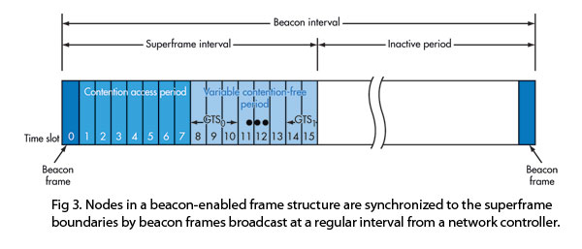
Superframe
A superframe is divided into two parts
Inactive: all station sleep
Active:
Active period will be divided into 16 slots
16 slots can further divided into two parts
Contention access period
Contention free period

Slide 26
Superframe
Beacons are used for
starting superframes
synchronizing with other devices
announcing the existence of a PAN
informing pending data in coordinators
In a “beacon-enabled” network,
Devices use the slotted CAMA/CA mechanism to contend for the usage of channels
FFDs which require fixed rates of transmissions can ask for guarantee time slots (GTS) from the coordinator

Slide 27
ZigBee Network Layer Protocols

Slide 28
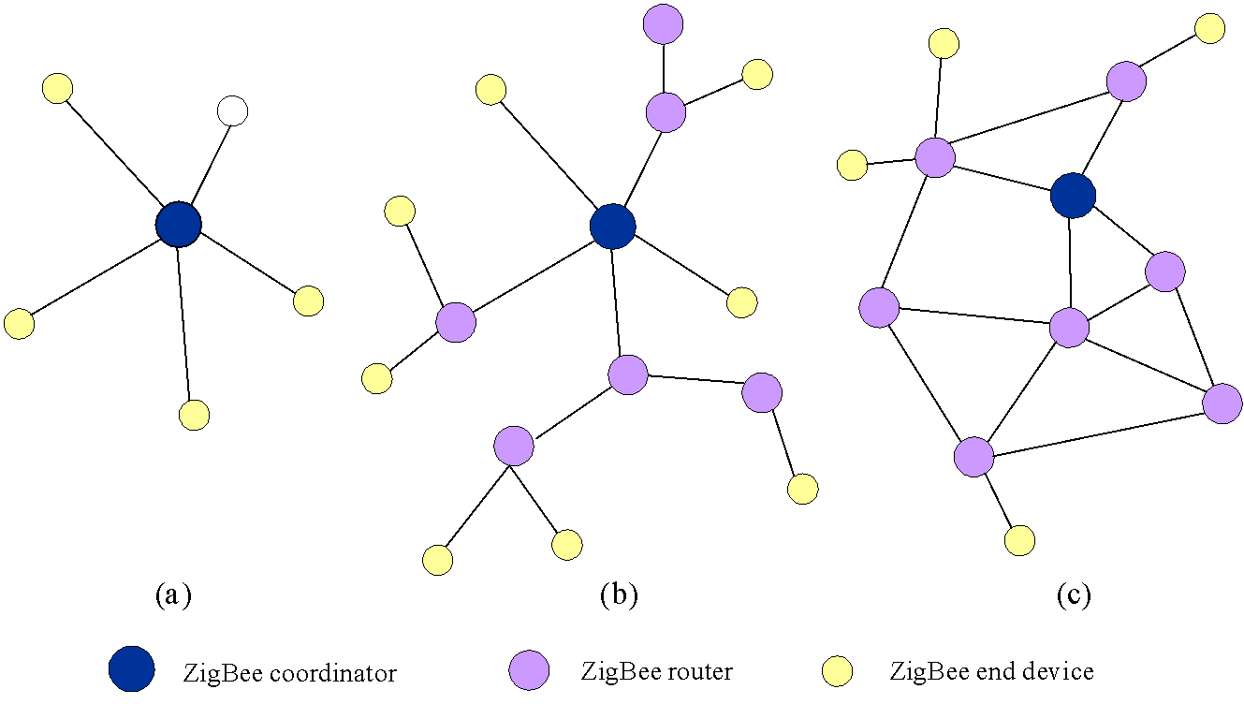
ZigBee Network Layer Overview
Three kinds of networks are supported: star, tree, and mesh networks

Slide 29
ZigBee Network Layer Overview
Three kinds of devices in the network layer
ZigBee coordinator: responsible for initializing, maintaining, and controlling the network
ZigBee router: form the network backbone
ZigBee end device: must be connected to router/coordinator
In a tree network, the coordinator and routers can announce beacons.
In a mesh network, there is no regular beacon.
Devices in a mesh network can only communicate with each other in a peer-to-peer manner

Slide 30
Address Assignment
In ZigBee, network addresses are assigned to devices by a distributed address assignment scheme
ZigBee coordinator determines three network parameters
the maximum number of children of a ZigBee router
the maximum number of child routers of a parent node
the depth of the network

Slide 31
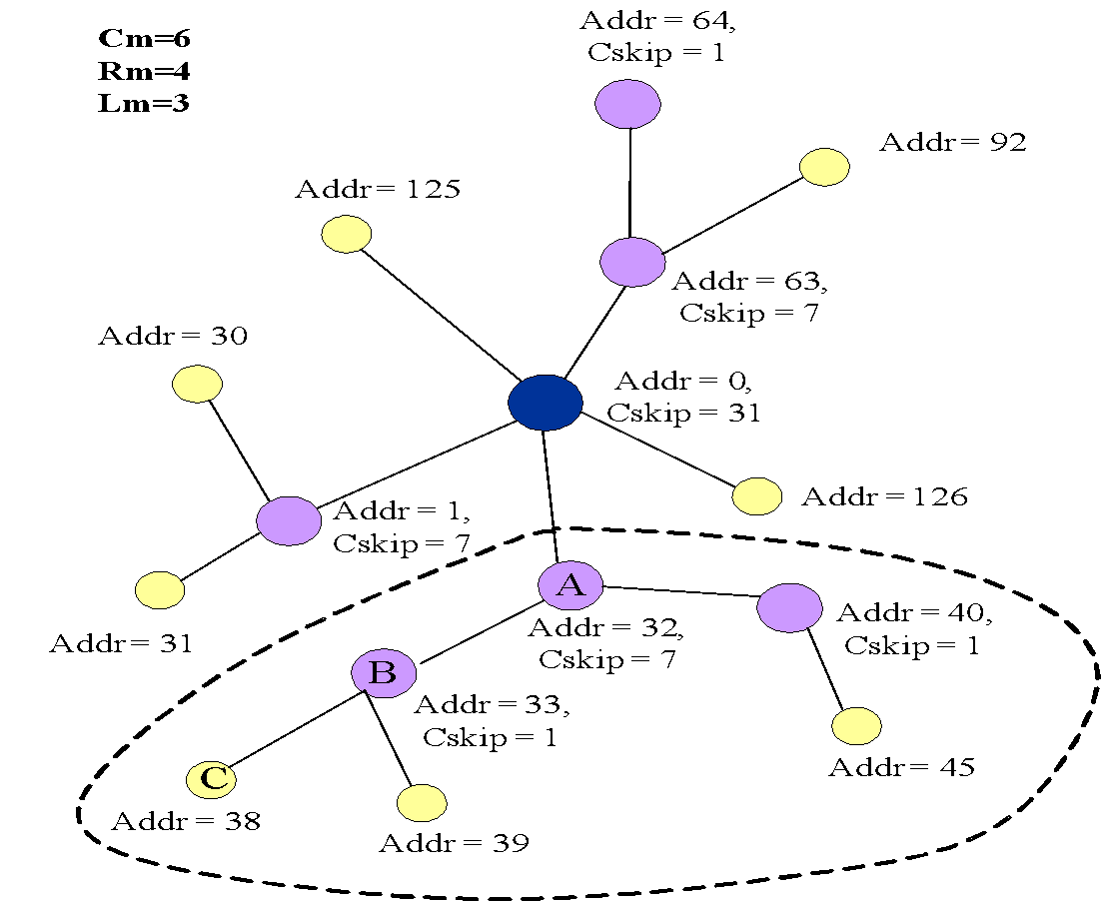
C

Slide 32
ZigBee Routing Protocols
In a tree network
Utilize the address assignment to obtain the routing paths
In a mesh network:
Routing Capability: ZigBee coordinators and routers are said to have routing capacity if they have routing table capacities and route discovery table capacities
There are 2 options:
Reactive routing: if having “routing capacity”
Tree routing: if having no routing capacity

Slide 33
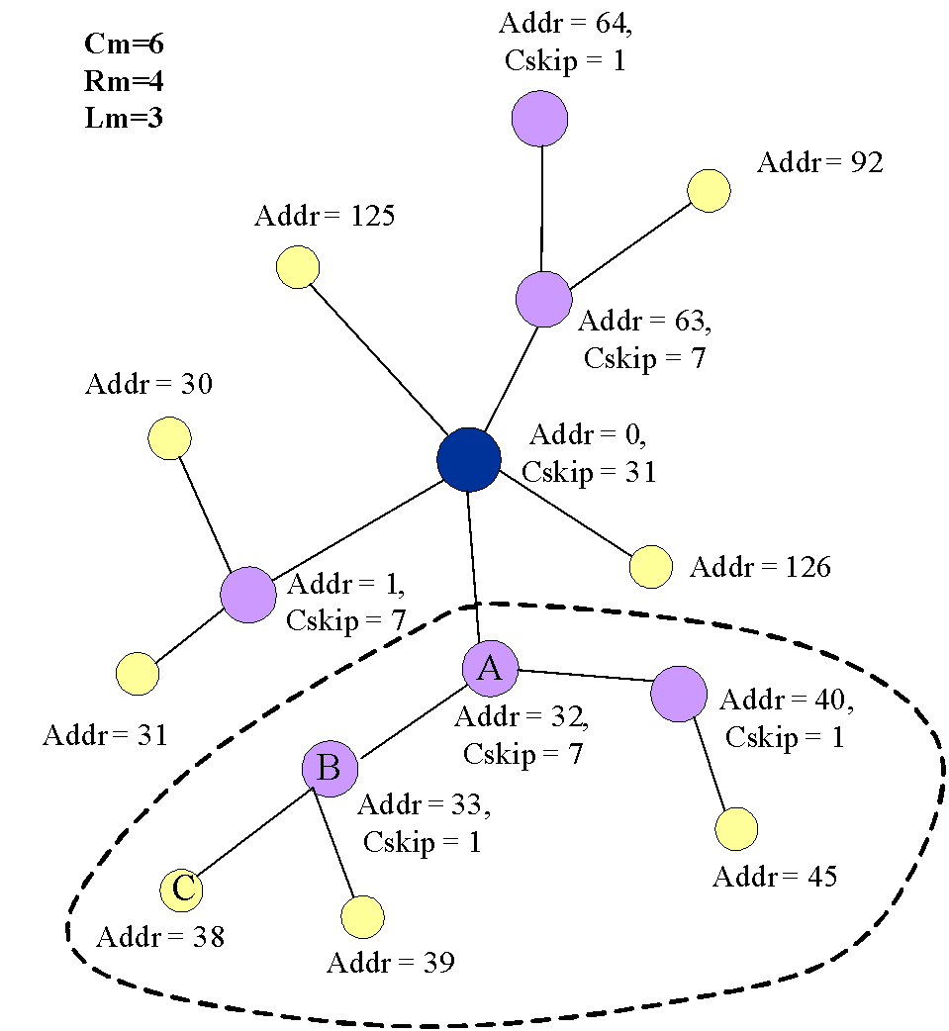
ZigBee Tree Routing
When a device receives a packet, it first checks if it is the destination or one of its child end devices is the destination
If so, accept the packet or forward it to a child
Otherwise, relay it along the tree
Example:
38 🡺 45
38 🡺 92

Slide 34
ZigBee Mesh Routing
Route discovery by using routing protocol
The cost of a link is defined based on the packet delivery probability on that link
Route discovery procedure
The source broadcasts a route request packet
Intermediate nodes will rebroadcast route request if
They have routing discovery table capacities
The cost is lower
Otherwise, nodes will relay the request along the tree
The destination will choose the routing path with the lowest cost and then send a route reply

Slide 35
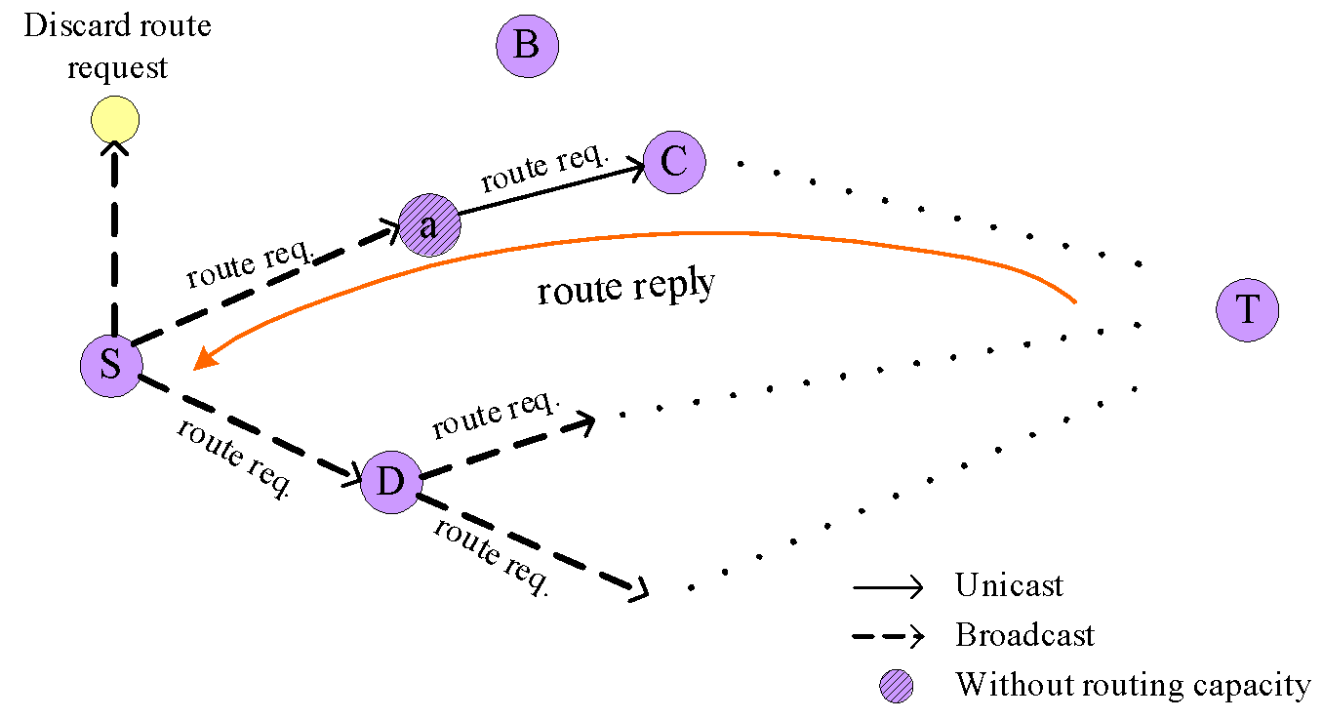
Routing in a Mesh network: Example

Slide 36
Summary of ZigBee network layer
 | Pros | Cons
Star | 1. Easy to synchronize 2. Support low power operation 3. Low latency | 1. Small scale
Tree | 1. Low routing cost 2. Can form superframes to support sleep mode 3. Allow multihop communication | 1. Route reconstruction is costly 2. Latency may be quite long
Mesh | 1. Robust multihop communication 2. Network is more flexible 3. Lower latency | 1. Cannot form superframes (and thus cannot support sleep mode) 2. Route discovery is costly 3. Needs storage for routing table

